Slide 1
HEALTHCARE DOMAIN REPORT

Slide 2
REPRESENTATION OF KPI IN EXCEL

Slide 3
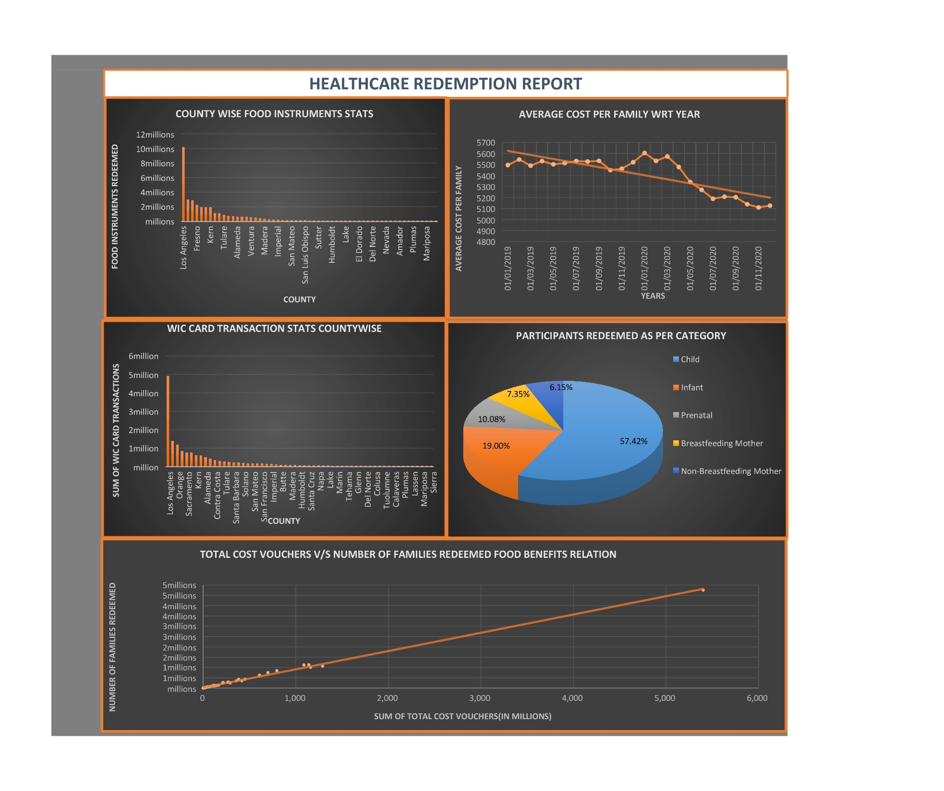

Slide 4
Interpretations:-
KPI 1- Countywise Food Instruments Stats
Directly related to the number of families redeemed in that particular county.
Los Angeles ranks first in the Food Instruments Stats as well as in the number of families redeemed.
The food instruments redeemed in 2020 is lesser than 2019 by 4%(approx.).
KPI 2- Average Cost trend with year
Slight decline in the average cost from 2019 to 2020.
Due to economy conditions and decrease in the number of food instruments, the average cost spend on each family has decreased.
KPI 3- Countywise WIC card transactions
There is sharp increase in the number of WIC card transactions for all the counties from 2019 to 2020.
Families started using the WIC card benefits more in 2020.
KPI 4- Percentage of participants redeemed as per category
Child category has the most number of participants.
In all counties, child category holds for more than 50%.
KPI 5- Total Cost Voucher v/s Number of families redeemed Food benefits relation
Follow a linear relationship.

Slide 5
REPRESENTATION OF KPI IN MYSQL

Slide 6
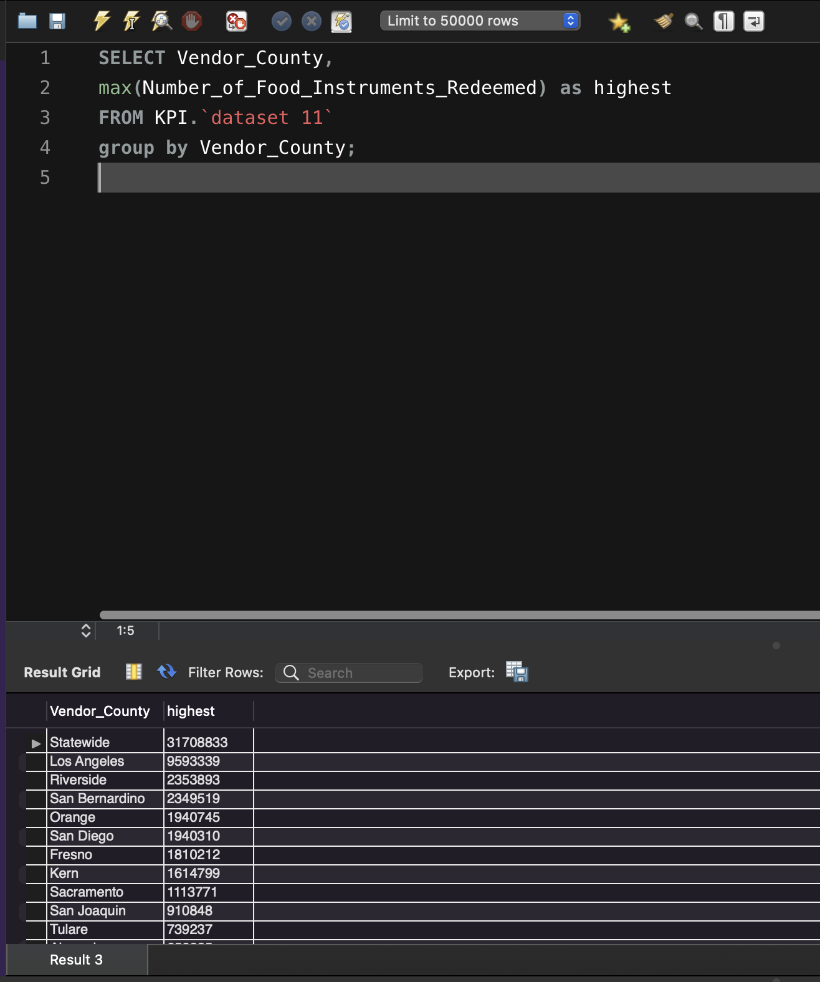
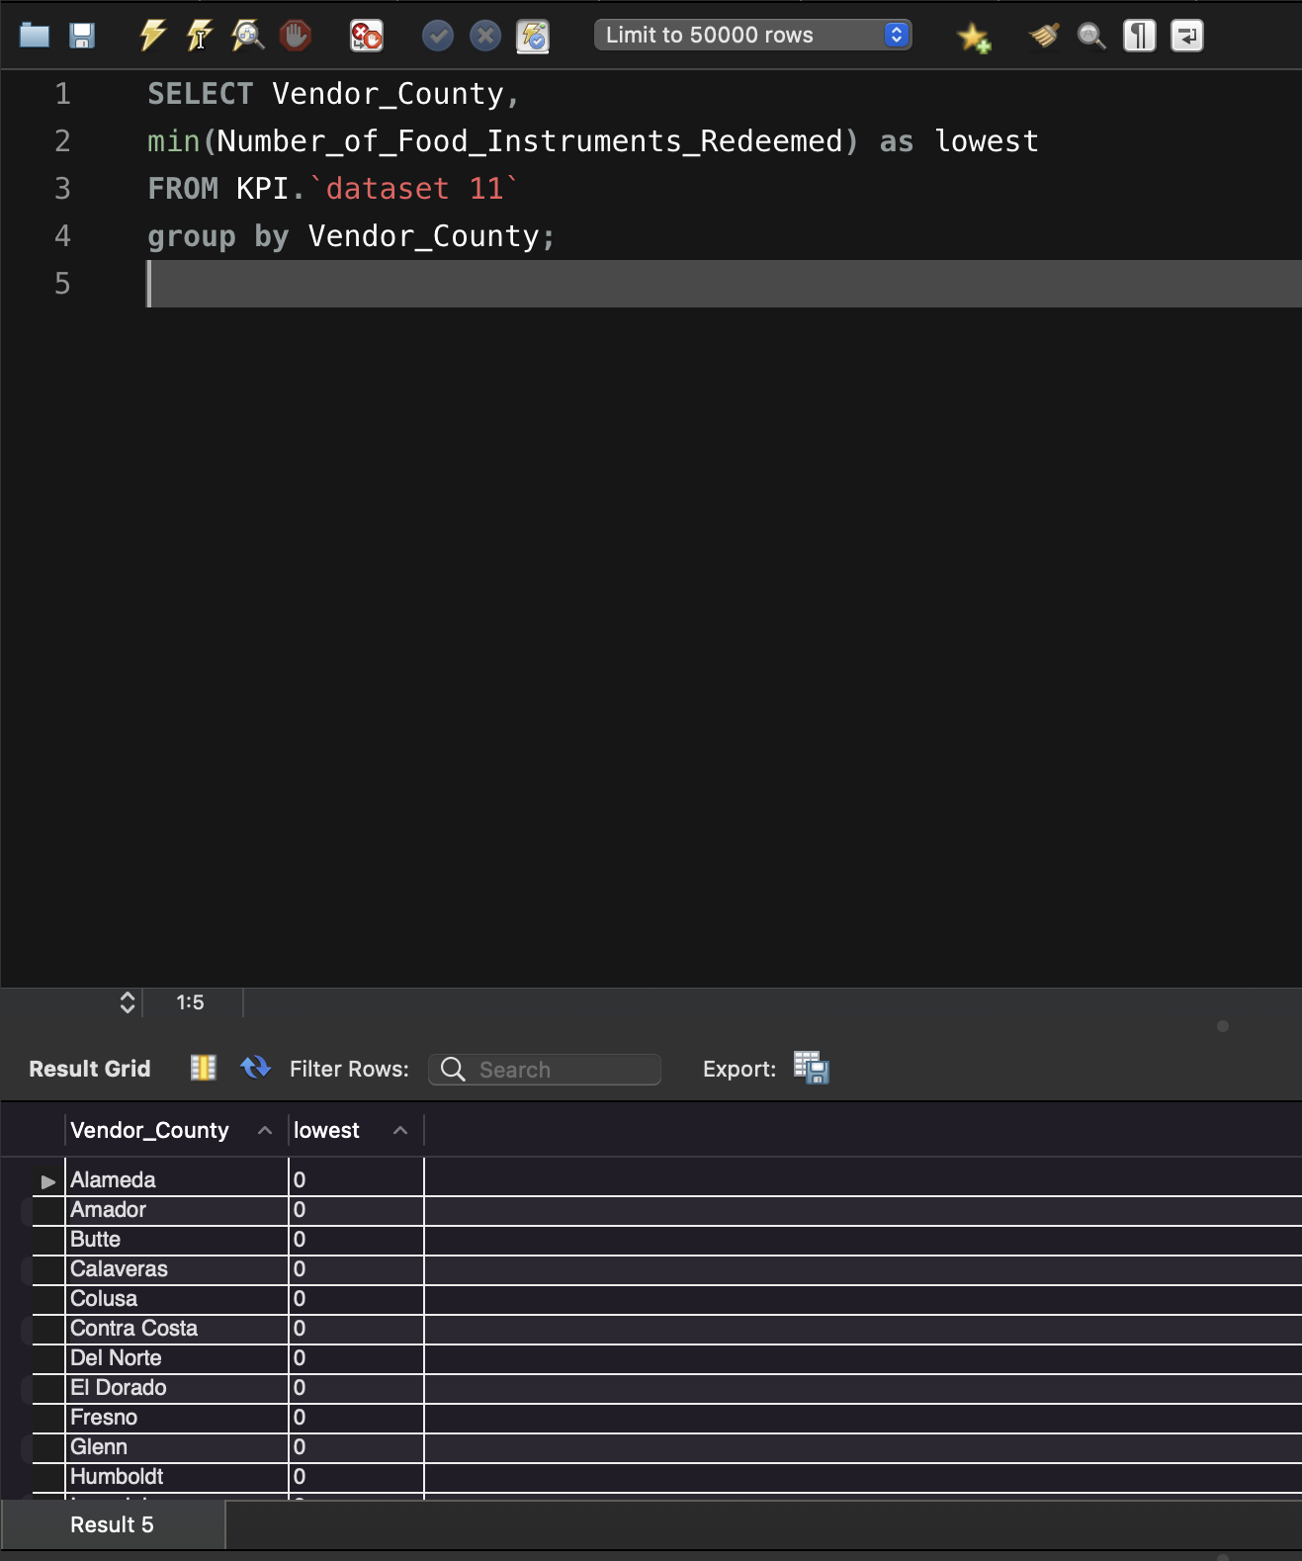
Country wise Food Instruments Stats

Slide 7
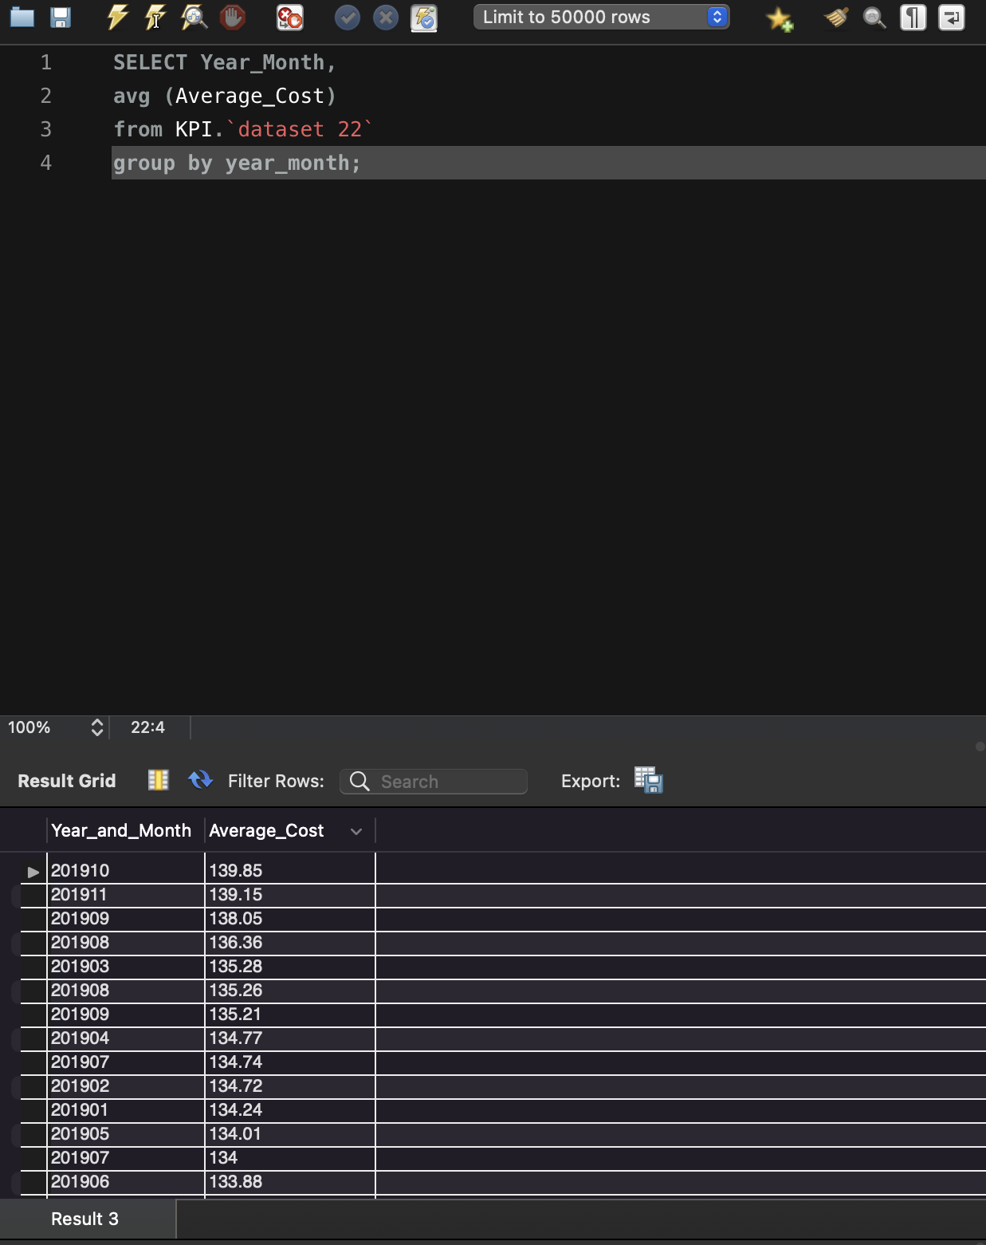
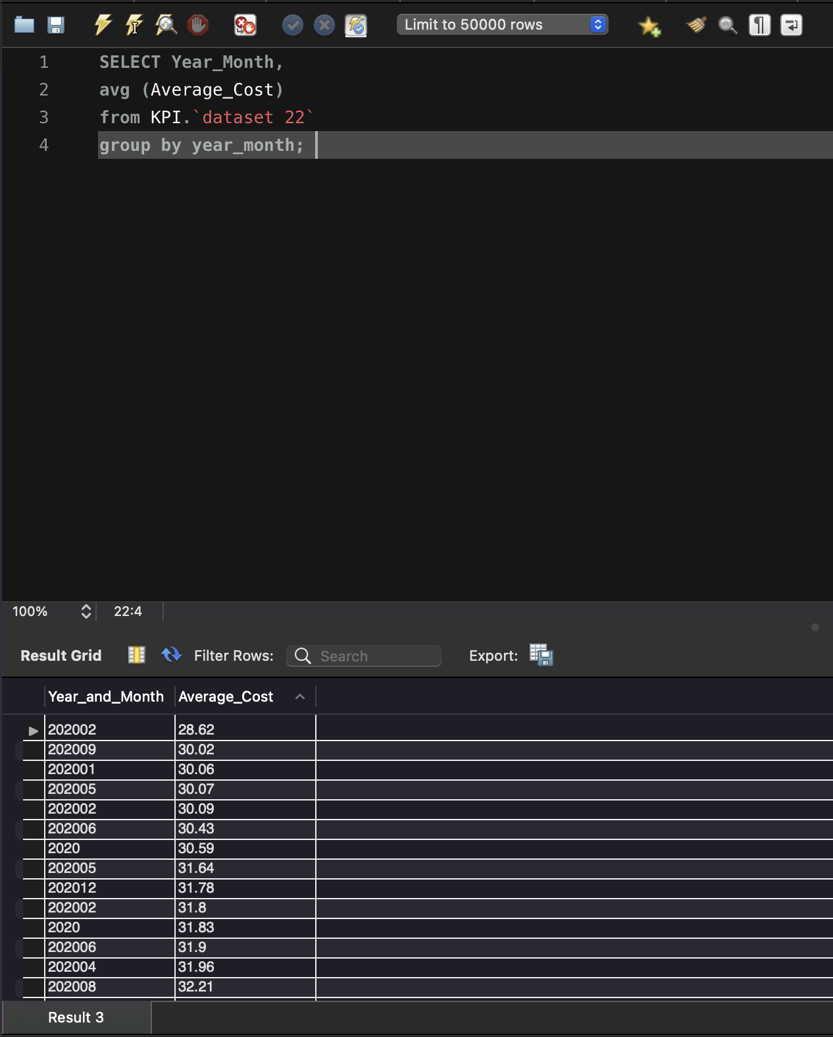
Average Cost trend with respect to year

Slide 8
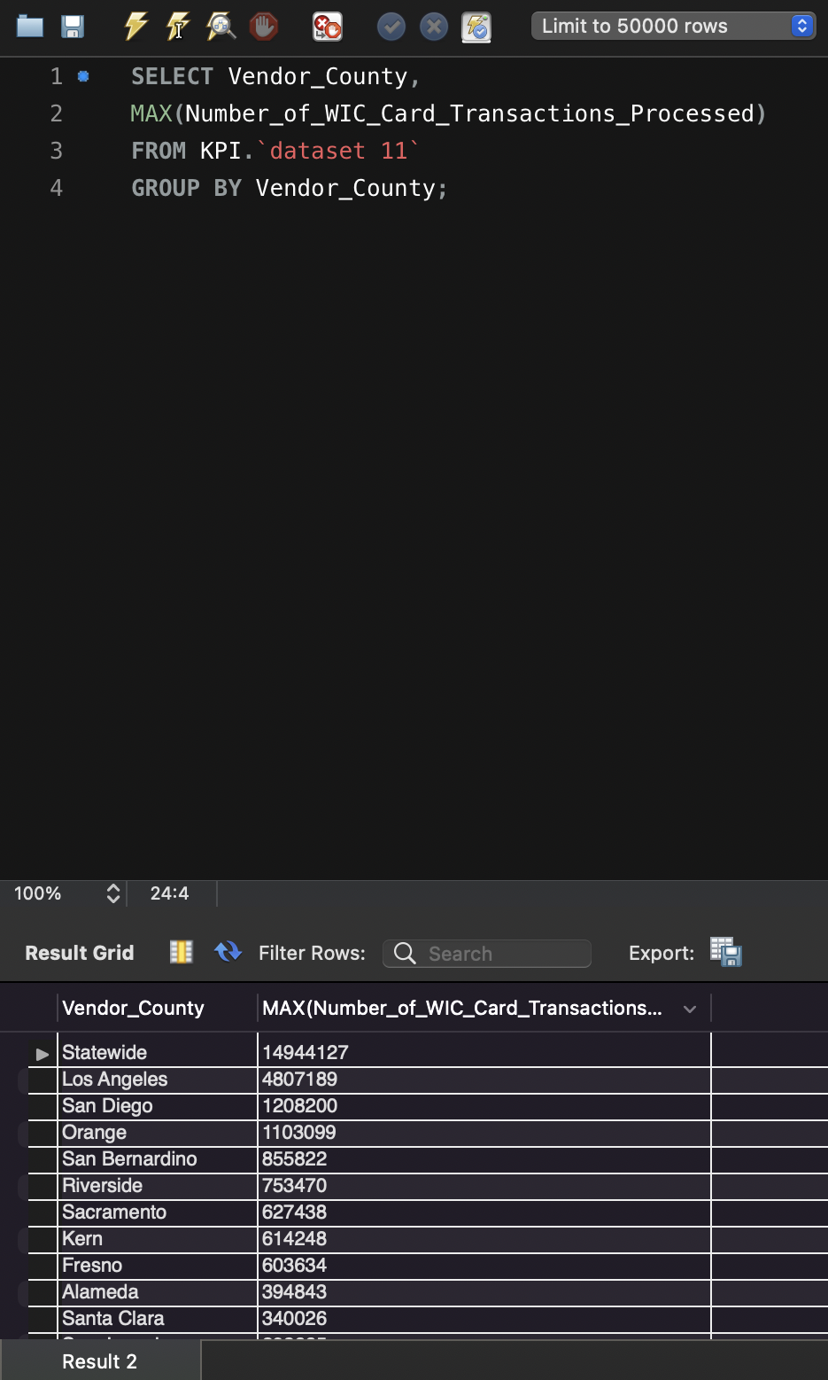
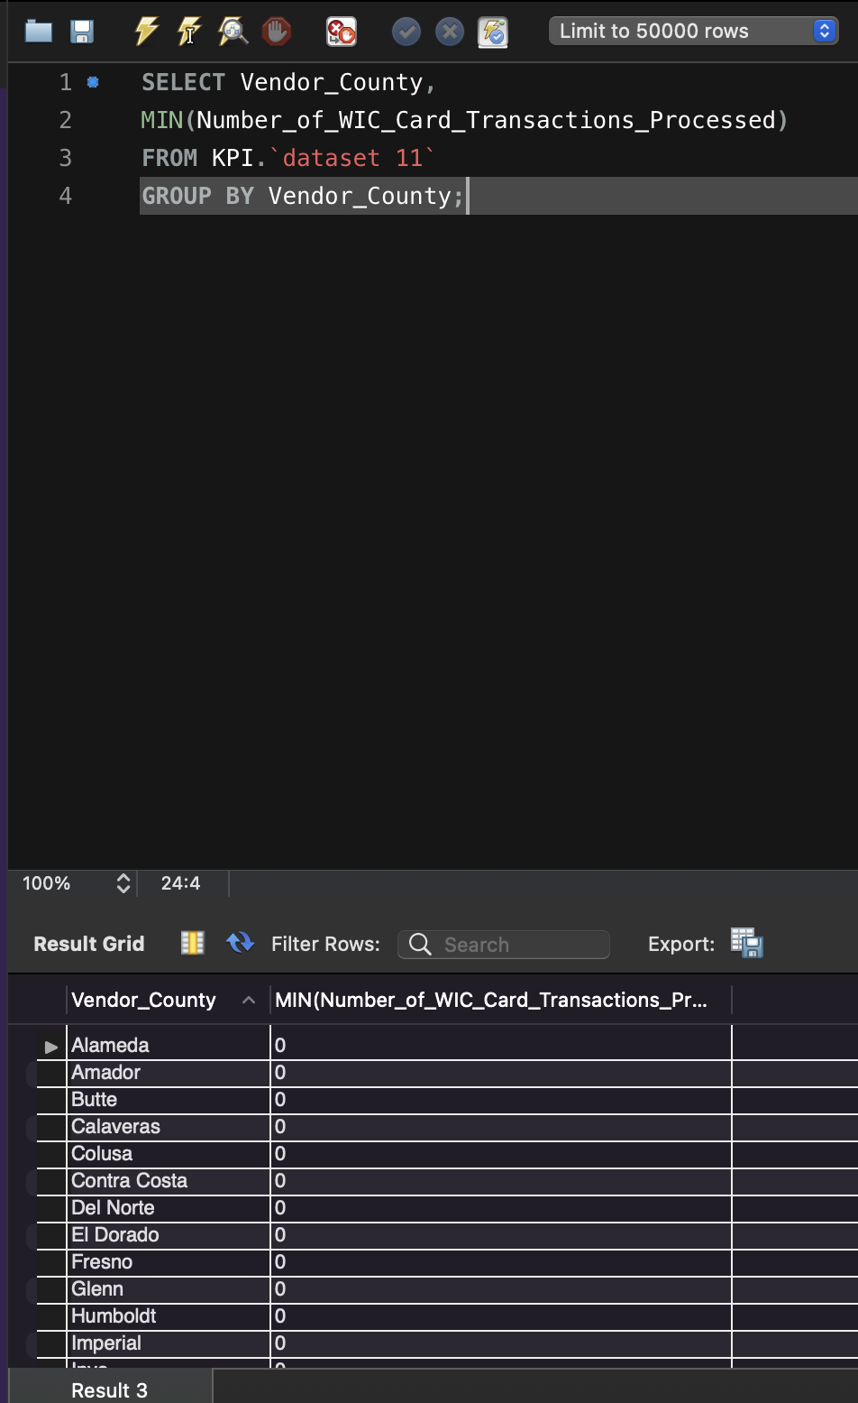
Country wise WIC Card Transaction Stats

Slide 9
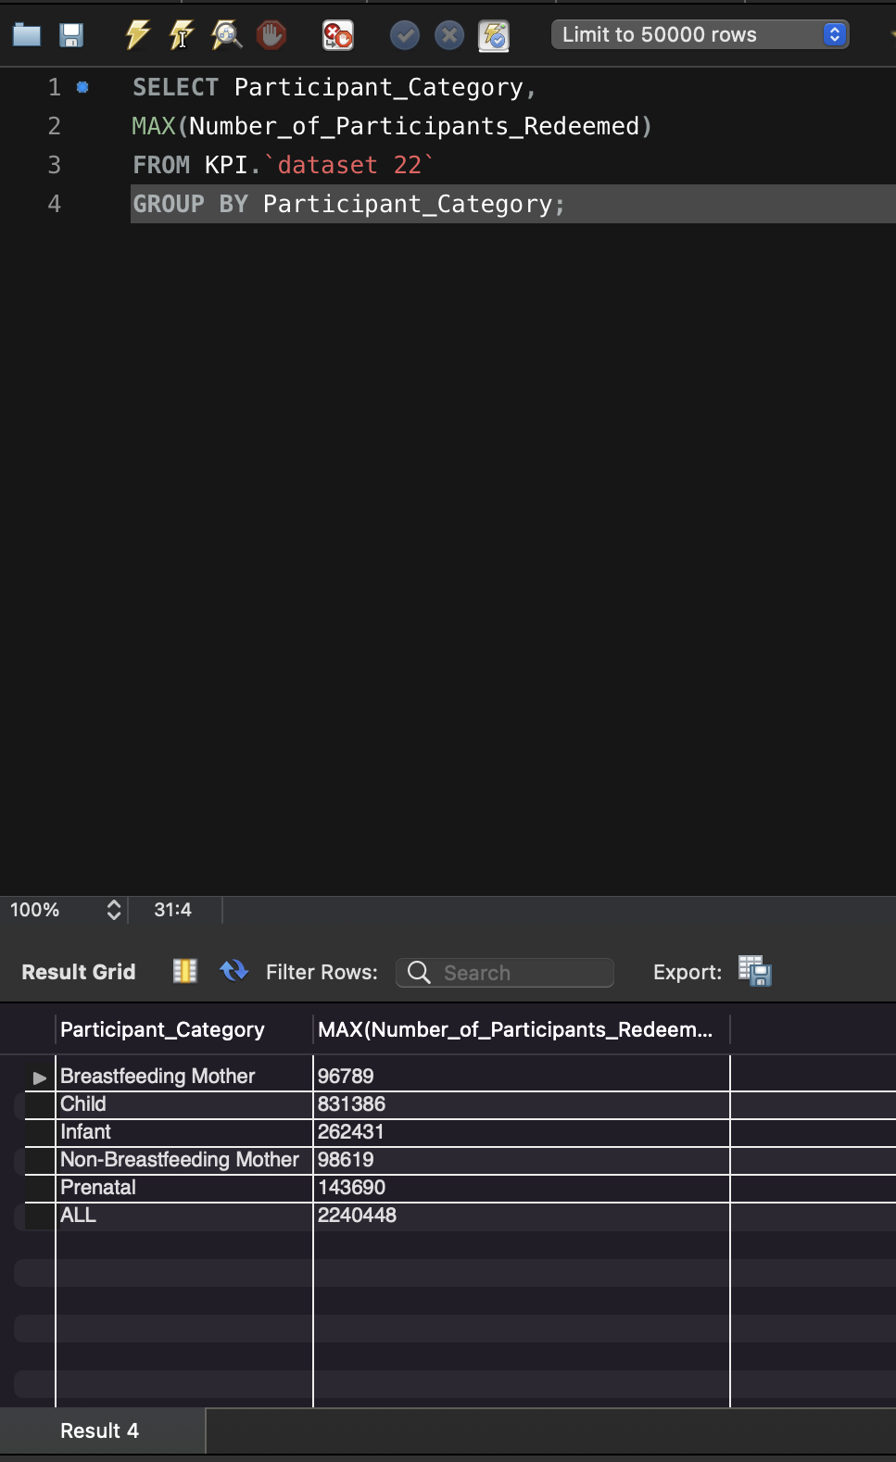
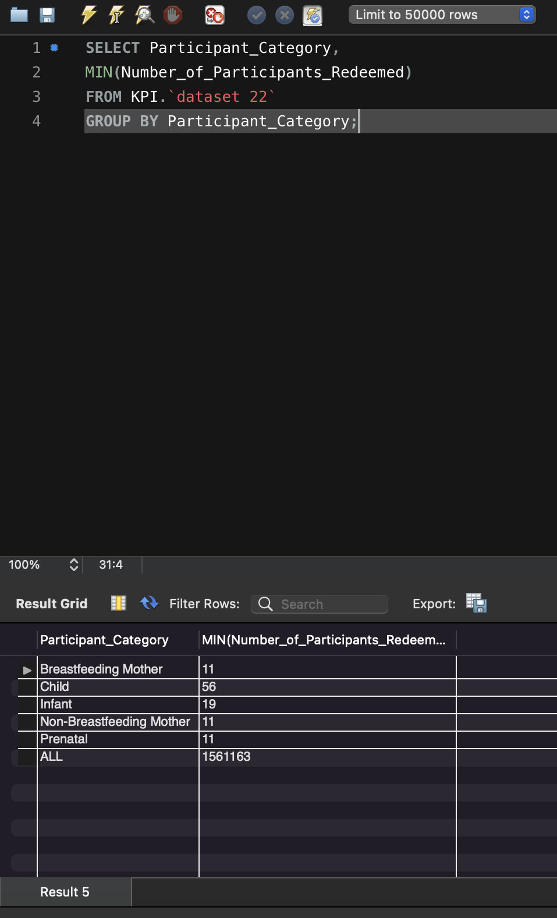
Percentage of Participants redeemed as per category

Slide 10
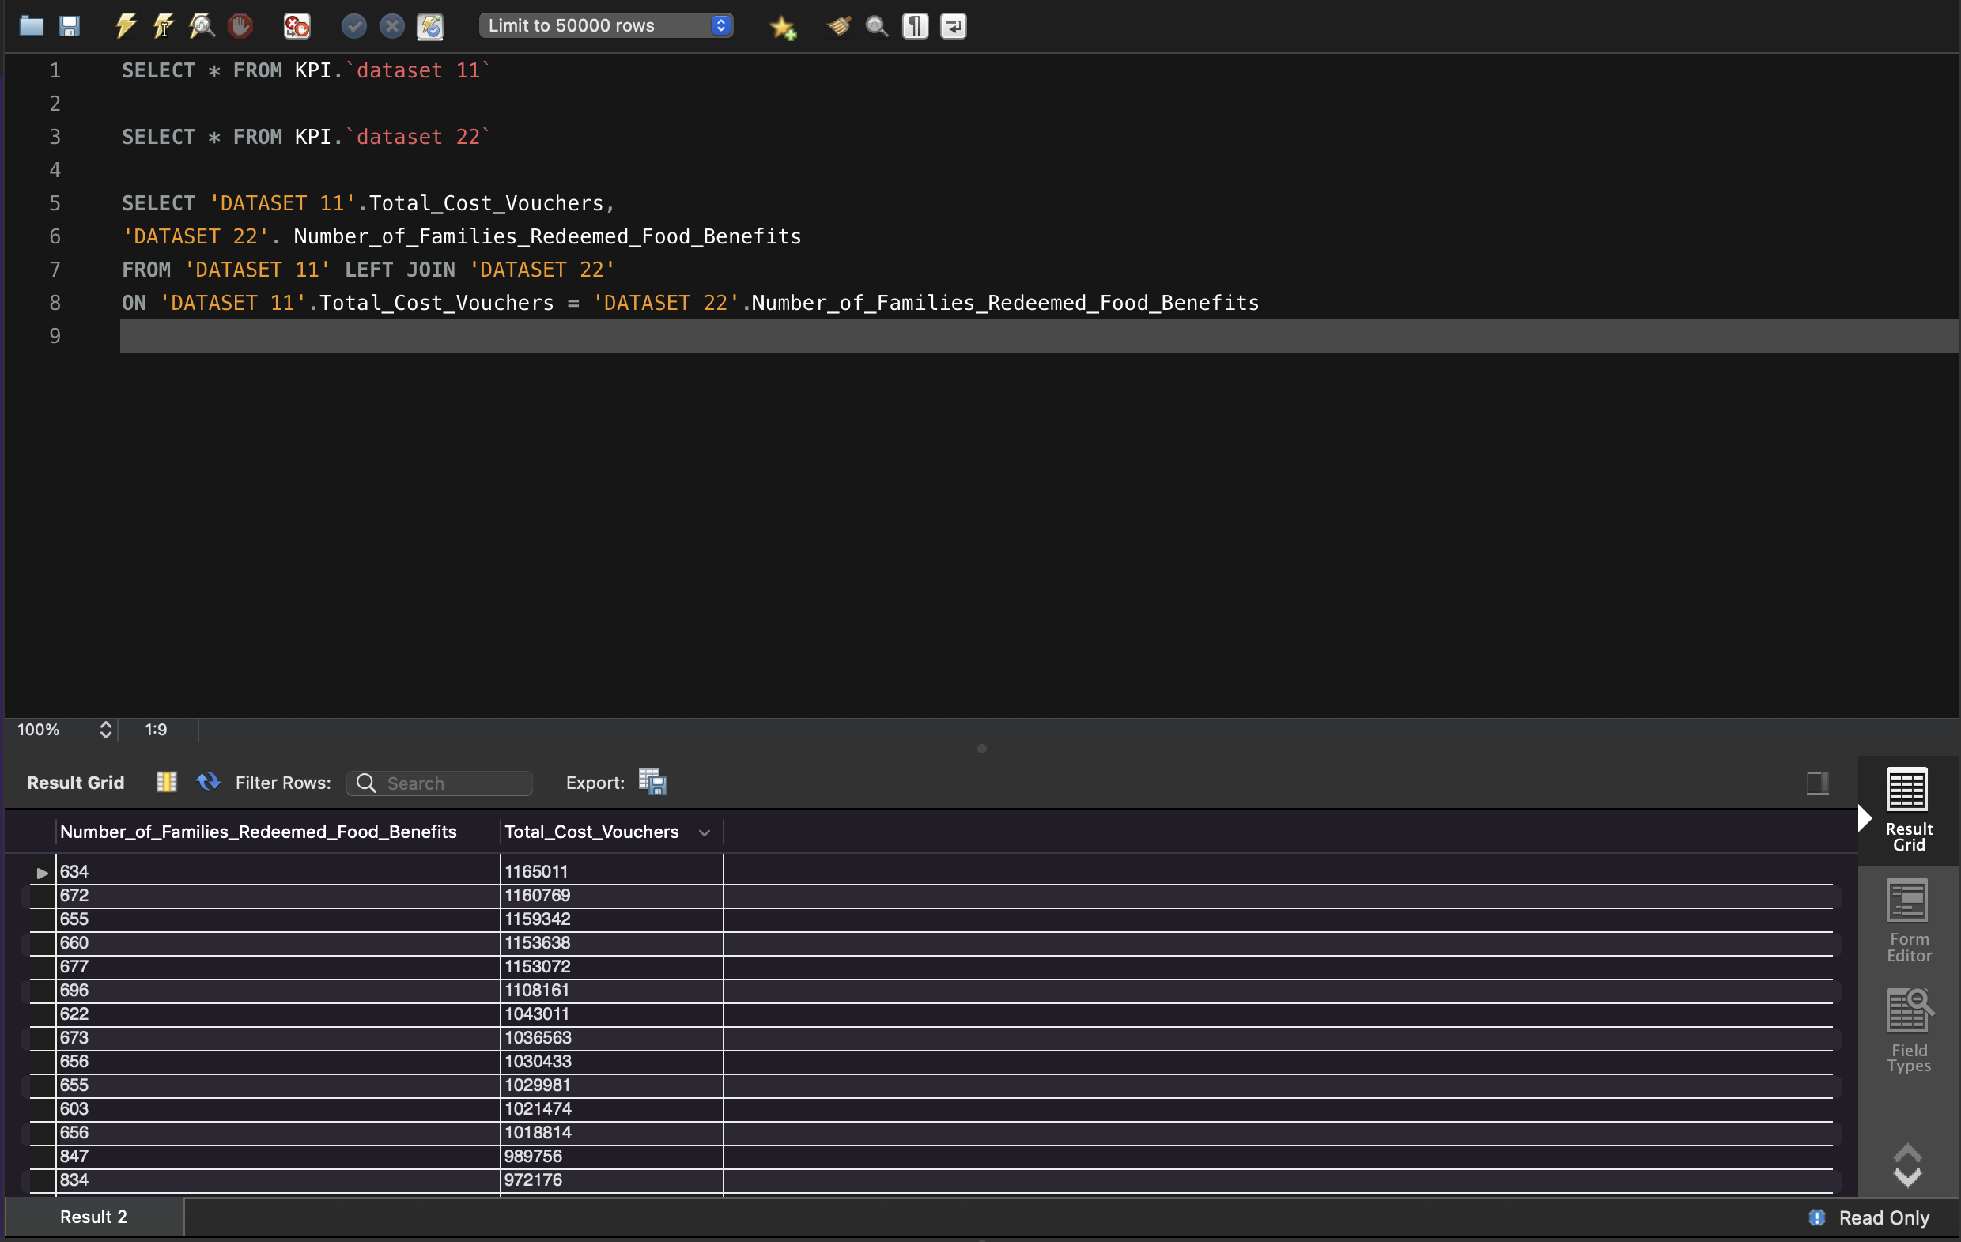
Total Cost Voucher Vs Number of Families Redeemed Food Benefits Relation

Slide 11
REPRESENTATION OF KPI IN TABLEAU

Slide 12
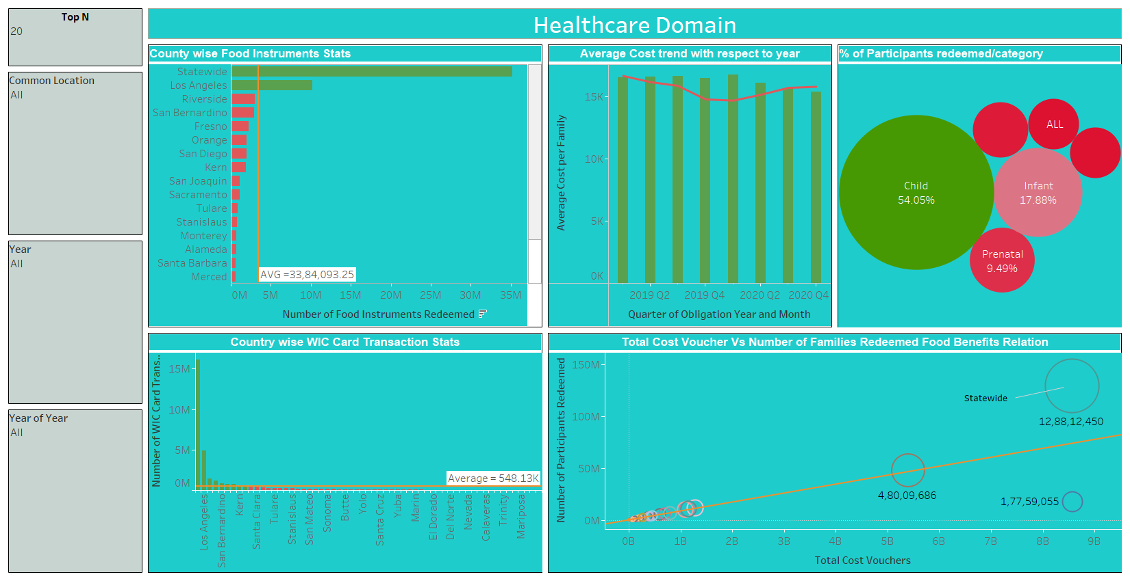

Slide 13
REPRESENTATION OF KPI IN POWER BI

Slide 14
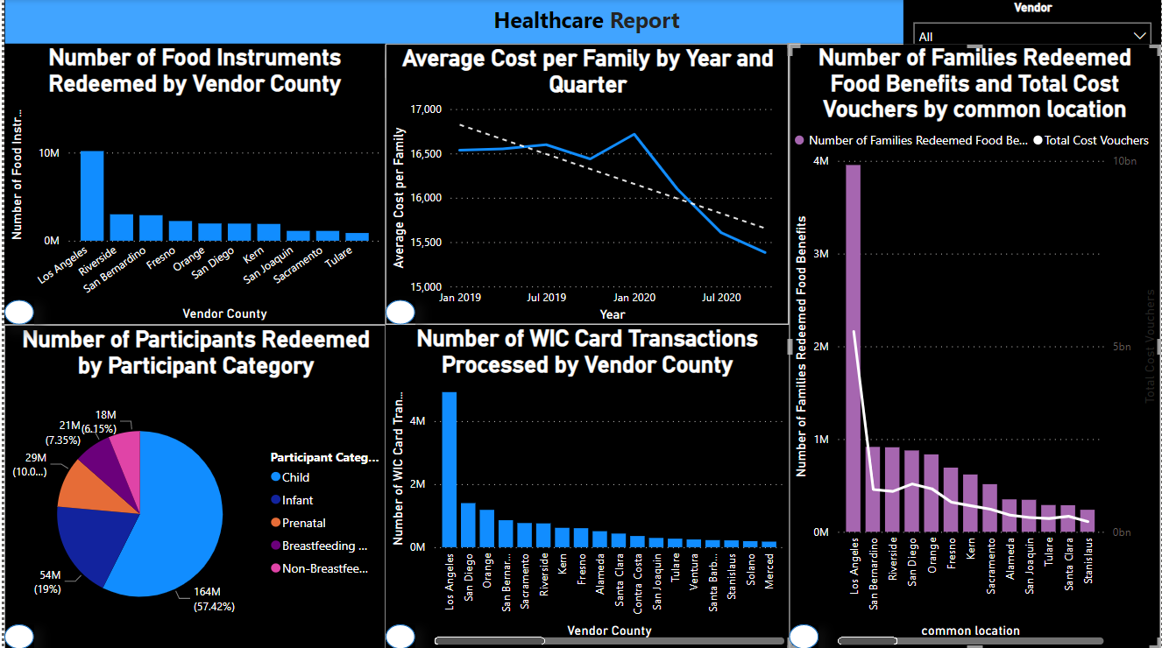

Slide 15
This Dashboard Represents KPI of Healthcare report.
The First KPI shows the Number of Food Instruments Redeemed by Vendor County.
In this we have added a tooltip that shows the particular vendor county.
Dollar amount redeemed for food instrument for that particular vendor county from that we can seen how much we have spend for that county.
thus we can say that the in individuals vendor county if the Dollar amount redeemed for food instrument is high then the no of food instruments redeemed by vendor county is also high.
The number of families redeemed food benefits by the county is high then also number of food instruments by vendor county is high.
So we can say that these two are directly proportional to each other
In the KPI2 its about the average cost per family by the year and quarter
And we have added trend line, drill down from that you can see the growth of the average cost per family
These are for only two year 2019-20 and the drill down shows according to your chose the year wise growth or quarter wise and the trend line.

Slide 16
In the KPI3 number of WIC card transaction processed by vendor county
This KPI also have the vendor county and the Dollar amount reimbursed for WIC card transaction.
Number of families redeemed by vendor county
The dollar amount reimbursed for WIC card transaction is directly proportional to the number of WIC transaction processed.
In the KPI4 we have number of participants redeemed by participant category
We have five category for that individual participants category we have created tooltip
In that we can see the total number of participants redeemed and number of voucher redeemed and the average cost by participant category
Child category have the more participant redeemed and the number of voucher redeemed is also high
In the KPI5 we have number of families redeemed food benefits and total cost voucher by common location
And the dashboard report we have added the vendor county filter from that we can see KPI for individual county also

Slide 17
THANK YOU

